Slide 1
Data visualization through Tableau Exploring Customer Patterns
By: Krushna Satyanarayan Takey
From: NIIT

Slide 2
Objective:
Analyze customer attrition data using data visualization and create an interactive dashboard to present insights.

Slide 3
Question set:- Task 1: Display the percentage of the attrited and the existing customers from the data. Task 2: Display gender-wise percentage of the attrited and the existing customers. Task 3: Display region-wise percentage of the attrited and the existing customers. Task 4: Display the percentage of the attrited and the existing customers for each card category. Task 5: Display the percentage of the attrited and the existing customers for each income category. Task 6: Display region-wise count of customers. Identify the region that has the maximum number of customers. Task 7: Create an interactive dashboard by following the given instructions:Create a Figma template for the dashboard.Design the dashboard with the charts created in tasks 1-6.Apply action filters on the charts created in tasks 1 and 6.

Slide 4
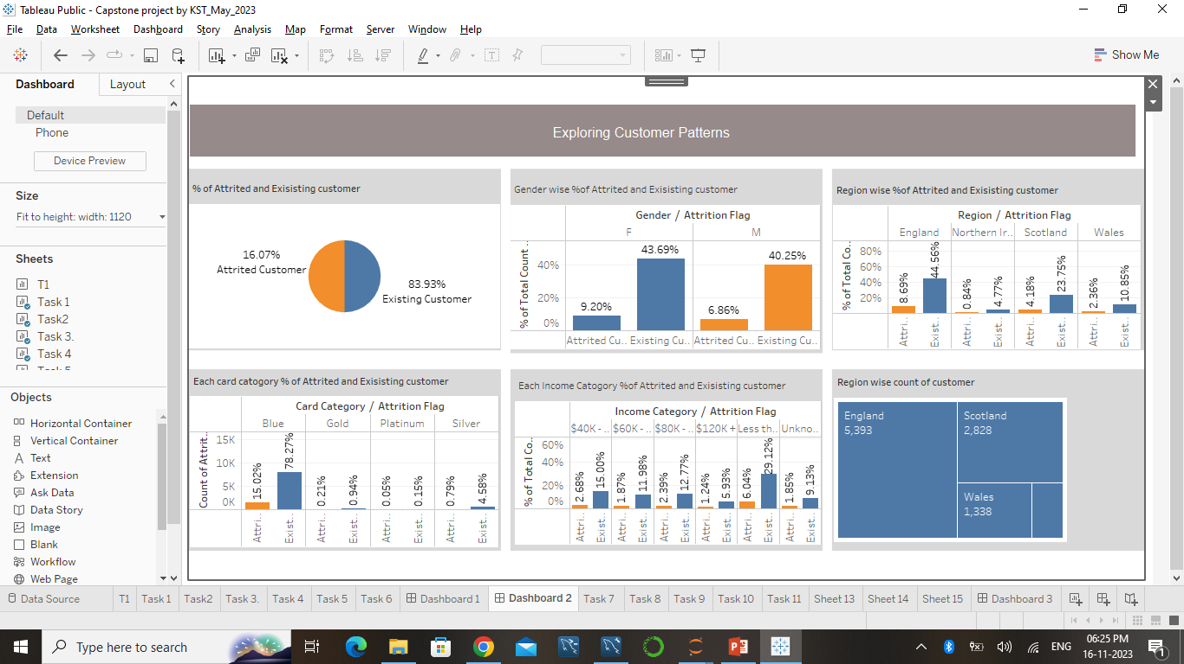
Link

Slide 5
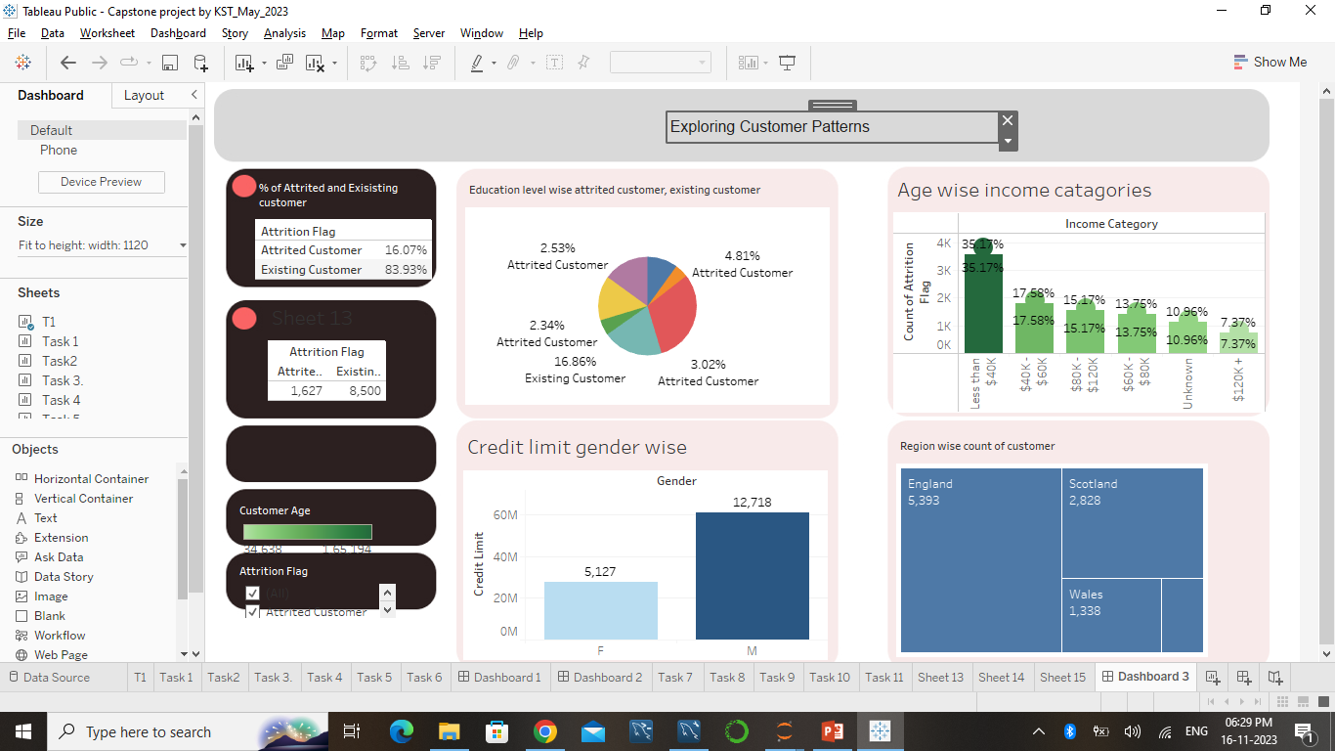
Link

Slide 6
Conclusion: Customer attrition is a significant issue, with varying rates across genders, regions, card categories, and income levels. Targeted retention strategies can improve customer retention.

Slide 7
Any question.

Slide 8
Thank You.

